Slide 1
COMP 4332 / RMBI 4310 Big Data Mining (Spring 2019)
Tutorial 8 Wide & Deep Learning
TA: Haojie Pan (hpanad@connect.ust.hk)

Slide 2
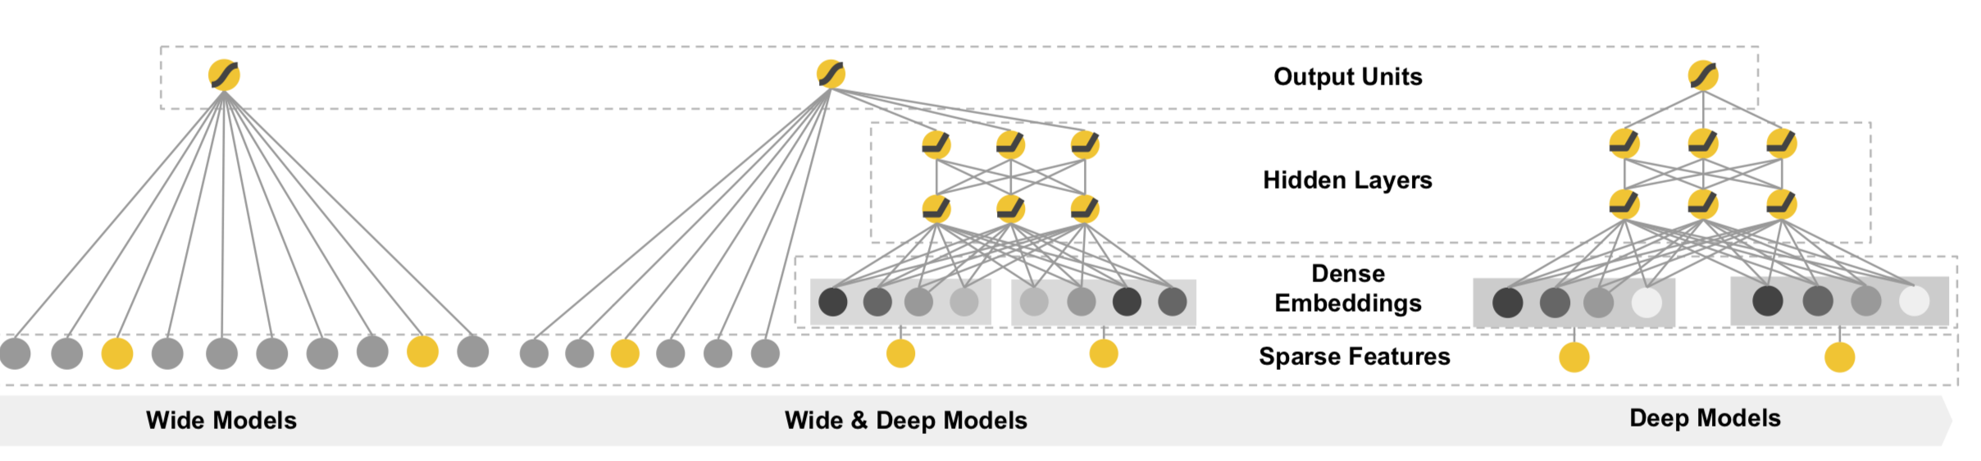
Wide & Deep Learning
Memorization
Generalization
Heng-Tze Cheng,Levent Koc,Jeremiah Harmsen,Tal Shaked,Tushar Chandra, Hrishi Aradhye, Glen Anderson, Greg Corrado, Wei Chai, Mustafa Ispir, et al. 2016. Wide & deep learning for recommender systems. In Proceedings of the 1st Workshop on Deep Learning for Recommender Systems. ACM, 7–10.

Slide 3
The wide model
Memorization
Exploiting the correlation available in the historical data

Slide 4
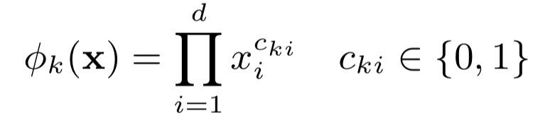
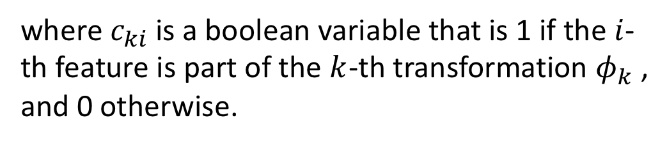
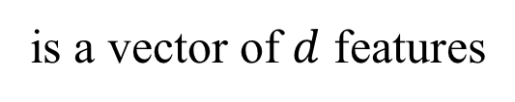
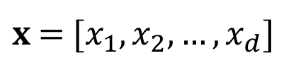
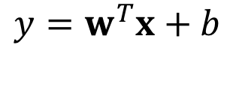
The wide model
Linear model:
$$y=w^{T}x+b$$
$x$ =$[x_{1}, x_{2}, …, x_{d}]$
is a vector of $d$ features
cross-product transformation :
where $c_{ki}$ is a boolean variable that is 1 if the$i$-th feature is part of the $k$-th transformation $φ_{k}$, and 0 otherwise.

Slide 5
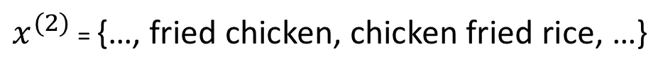
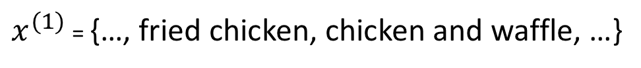
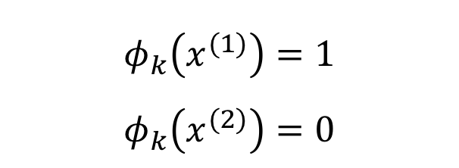
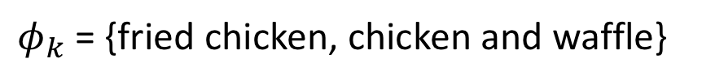
The wide model
cross-product transformation :
$φ_{k}$ = {fried chicken, chicken and waffle}
$$φ_{k}\left(x^{(1)}\right)=1$$
$$φ_{k}\left(x^{(2)}\right)=0$$
$x^{(1)}$ = {…, fried chicken, chicken and waffle, …}
$x^{(2)}$ = {…, fried chicken, chicken fried rice, …}

Slide 6
The deep model
Generalization
New feature combinations that have never or rarely occurre in the past

Slide 7
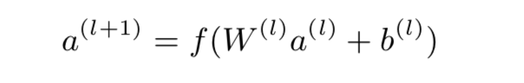
The deep model

Slide 8
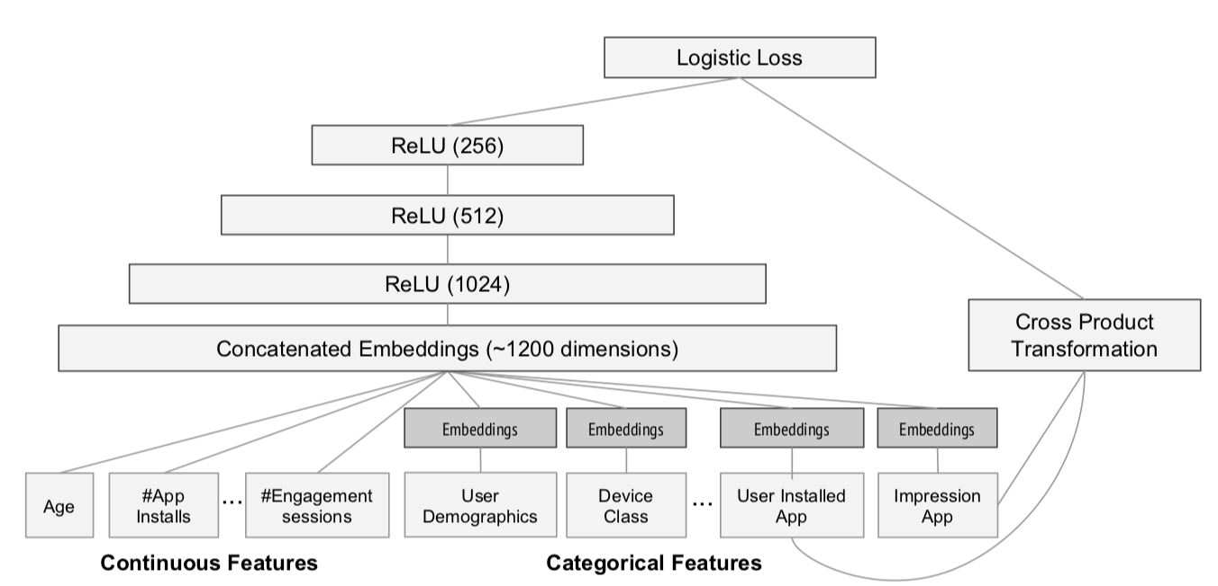
The wide & deep model

Slide 9
Wide & Deep for Rating Prediction

Slide 10
Continuous Features
continuous_columns = [
"user_average_stars",
"user_cool",
"user_fans",
"user_review_count",
"user_useful",
"user_funny",
"item_is_open",
"item_latitude",
"item_longitude",
"item_review_count",
"item_stars”
]

Slide 11
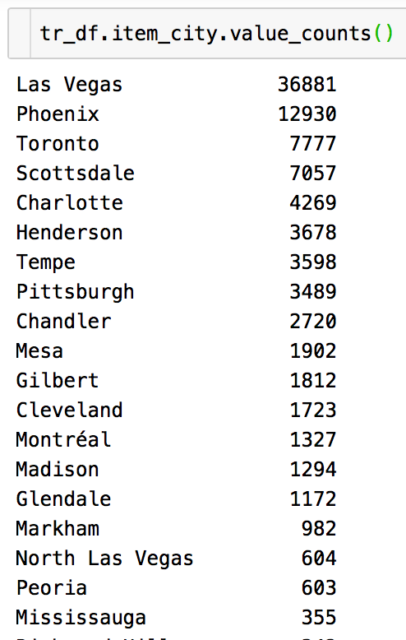
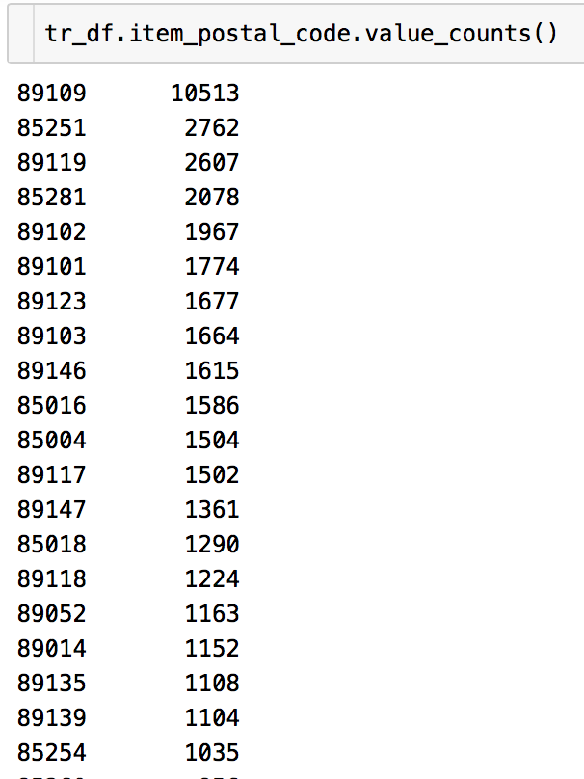
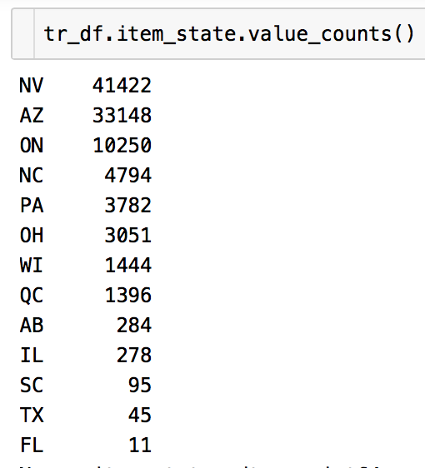
Deep Features

Slide 12
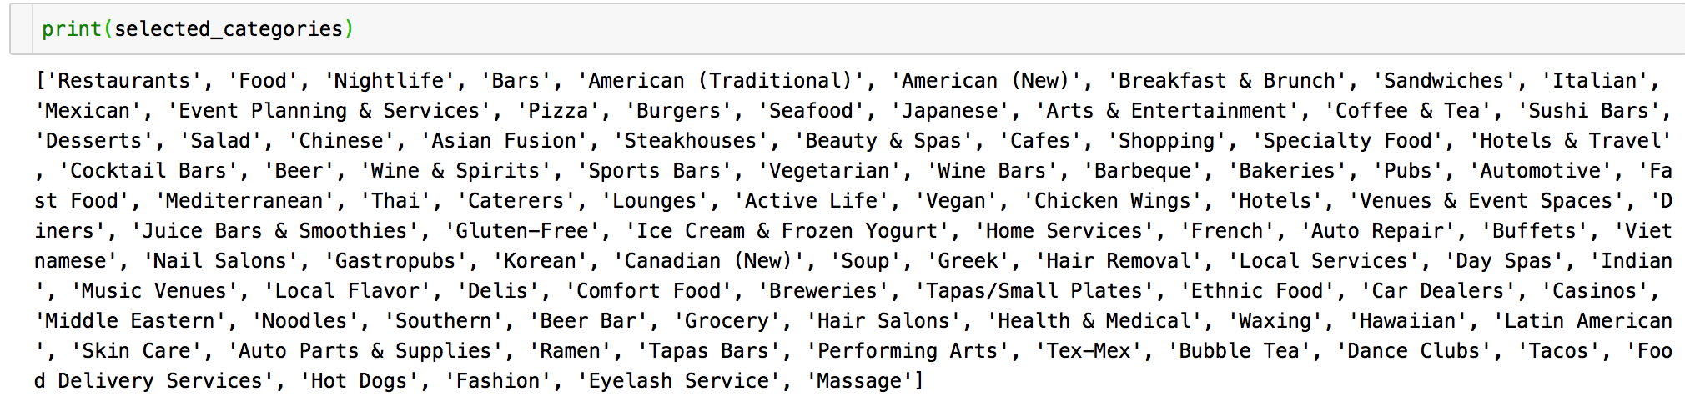
Wide Features

Slide 13
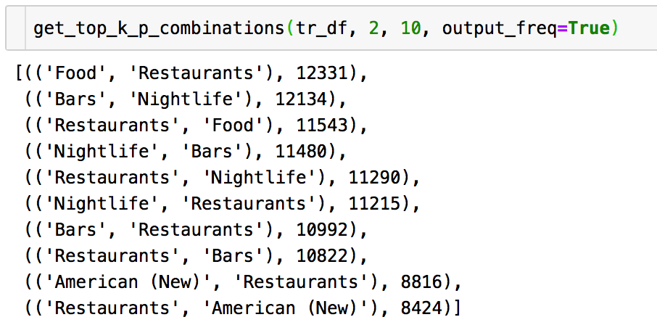
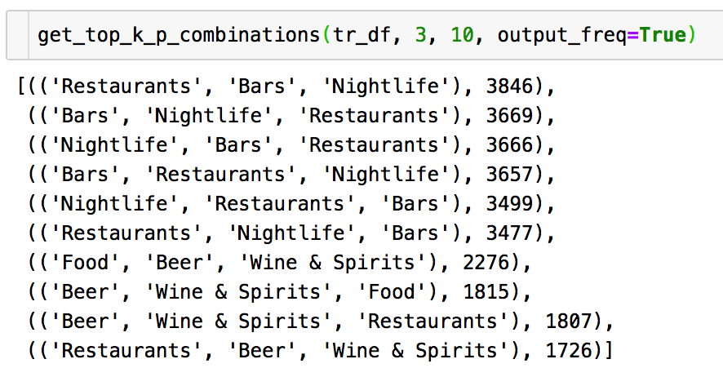
Wide Features

Slide 14
Wide & Deep Model
# Continuous Input
continuous_input = Input(shape=(len_continuous,), dtype='float32', name='continuous_input’)
input_list.append(continuous_input)

Slide 15
Wide & Deep Model
# Embedding Input
emb_list = []
for vocab_size in deep_vocab_lens:
_input = Input(shape=(1,), dtype='int32')
input_list.append(_input)
_emb = Embedding(output_dim=embed_size, input_dim=vocab_size,
input_length=1)(_input)
_emb = Reshape((embed_size,))(_emb)
emb_list.append(_emb)

Slide 16
Wide & Deep Model
# MLP for deep input
deep_input = Concatenate()(emb_list + [continuous_input])
dense_1 = Dense(256, activation='relu')(deep_input)
dense_1_dp = Dropout(0.3)(dense_1)
dense_2 = Dense(128, activation='relu')(dense_1_dp)
dense_2_dp = Dropout(0.3)(dense_2)
dense_3 = Dense(64, activation='relu')(dense_2_dp)
dense_3_dp = Dropout(0.3)(dense_3)

Slide 17
Wide & Deep Model
# Wide input
wide_input = Input(shape=(len_wide,), dtype='float32')
input_list.append(wide_input)

Slide 18
Wide & Deep Model
# Output Layer
fc_input = Concatenate()([dense_3_dp, wide_input])
model_output = Dense(1)(fc_input)

Slide 19
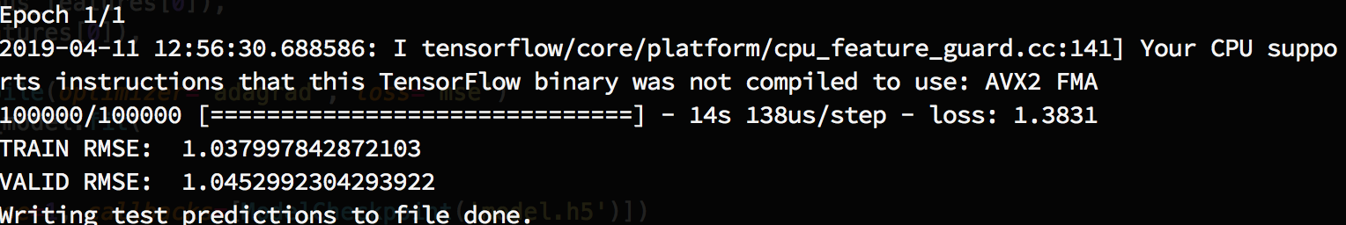
Results
$ python tut8_skeleton.py

Slide 20
Grading Rule
Grade | RMSE on validation | Remark
60% | 1.0839 | Neural CF, tutorial 7
80% | 1.0432 | Wide&Deep, tutorial 8
90% | 1.0355 | Just parameter tuning
100% | 1.0303 | Parameter tuning + a little feature engineering
Bonus | 1.0228 | /

Slide 21
FAQ
The project3 asked us to submit a prediction file with our student id as the name. Does it mean it is no longer a group project?
No, it is still a group project, you can set it to any student id of your group members.

